Slide 1
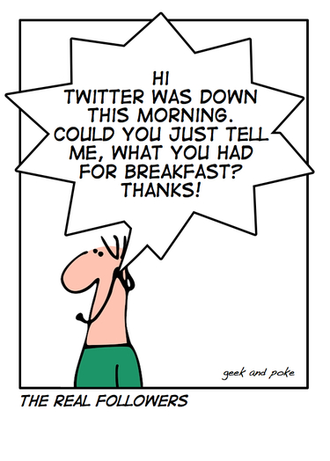
Introduction to Social Network Analysis and Models
Lecture 2
范耀中
Yao-Chung Fan
yfan@nchu.edu.tw,
Dept. of Computer Science,
National Chung Hsing University

Slide 2
Lecture Outline
Part I:
Social Network Analysis
Part II:
Social Network Models

Slide 3
Social Network Models

Slide 4
Models for Real World Network

Slide 5
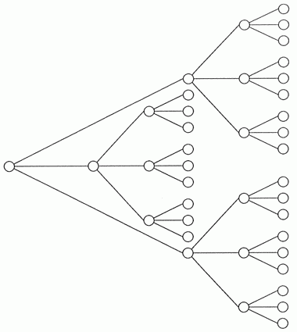
Network Properties
Average Distance between Pairs (small)
Transitivity (high)
Degree Distribution (power law)
Network Resilience (weak under attack)
a graph has k average degree then
the first neighbours will be k
the second neighbours ~ k²
……………..
the d-th neighbours ~ k^{d}

Slide 6
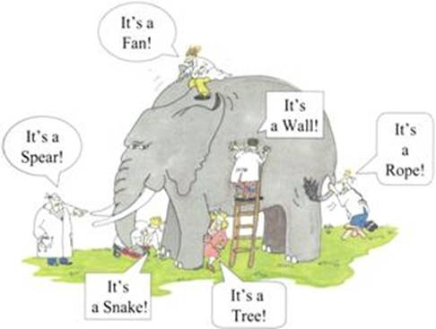
What the structure of a social network look like?

Slide 7
Five Models
Regular Model
Random Graph Model
Small World Model/Watts-Strogatz Model
Scale Free Model/BA Model
Geographical Small World Model

Slide 8
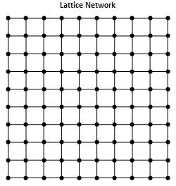
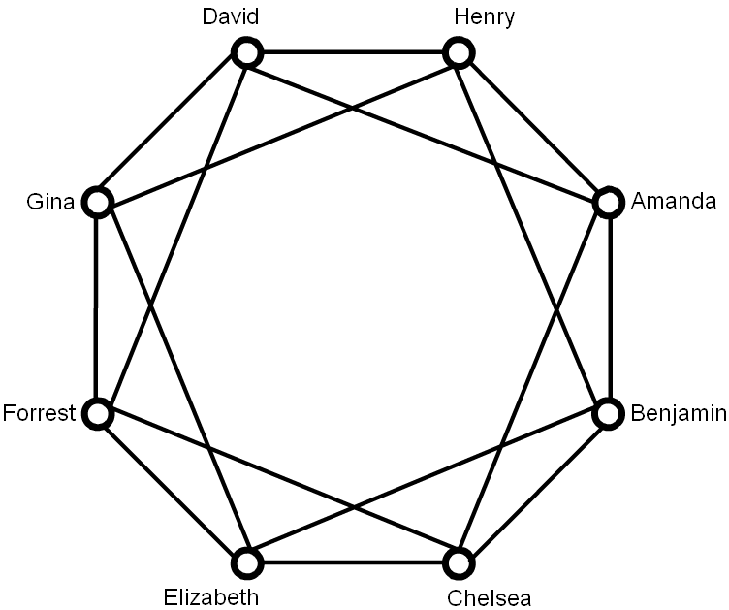
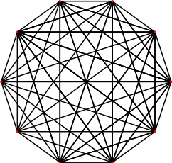
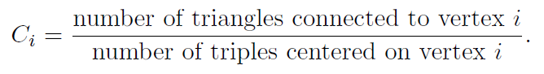
Regular Models

Slide 9
Why the regular models are not good ones ?

Slide 10

Network Properties
Average Distance between pairs (small)
Transitivity (high)
Degree Distribution (power law)
Network Resilience (weak under attack)

Slide 11
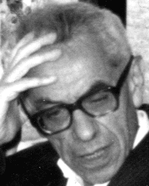
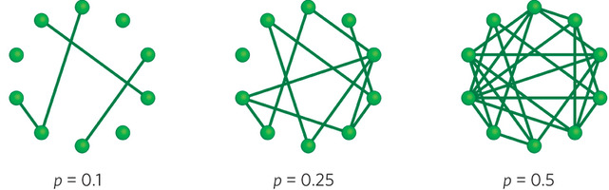
Random Graph Model
Standard Theory of Random Graph (Erdös and Rényi 1960)
Random Graphs are composed by starting with n vertices. With probability p two vertices are connected by an edge
http://ccl.northwestern.edu/netlogo/models/run.cgi?GiantComponent.884.534

Slide 12
Random Graph Model Property
The number m of edges in a Random Graph is a random variable whose expectation value is
The probability to form a particular Graph G(N,m) is given by
The degree has expectation value
It is easy to check that the degree probability distribution is given by

Slide 13
Random Graph Model Property
Clustering Coefficient:
Average Distance between pairs:
a graph has k average degree then
the first neighbours will be k
the second neighbours ~ k²
……………..
the d-th neighbours ~ k^{d}

Slide 14
Why the random graph model is inadequate ?

Slide 15
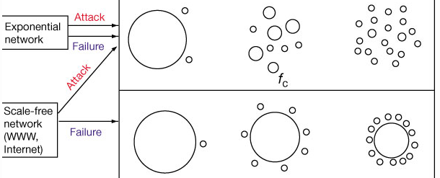
Network Resilience
Source: Error and attack tolerance of complex networks. Réka Albert, Hawoong Jeong and Albert-László Barabási.
http://ccl.northwestern.edu/netlogo/models/run.cgi?GiantComponent.884.534

Slide 16
Network Properties
Average Distance between Pairs (small)
Transitivity (high)
Degree Distribution (power law)
Network Resilience (weak under attack)

Slide 17
Five Models
Regular Model
Random Graph Model
Small World Model/Watts-Strogatz Model
Scale Free Model/BA Model
Geographical Small World Model

Slide 18
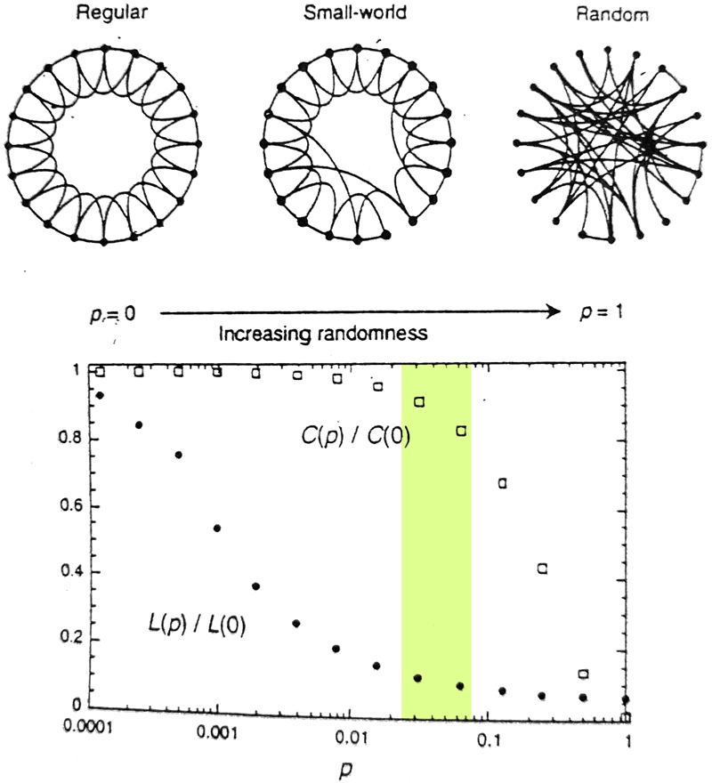
Small World Model
Watts and Strogatz Model (Nature 1998)
The original graph was very clustered: we keep this high clustering.
In the model, we begin with a low-dimension regular graph
And by creating shortcuts, we decrease the average distance, i.e. create a small-world effect.
For each edge, move one of its ends to another vertex with probablity p.

Slide 19
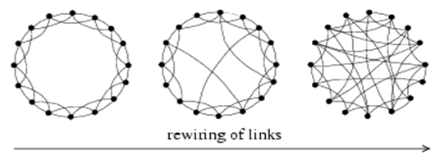
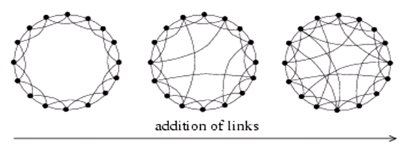
Watts-Strogatz model: Generating small world graphs
Select a fraction p of edges
Reposition on of their endpoints
Add a fraction p of additional
edges leaving underlying lattice
intact
As in many network generating algorithms
Disallow self-edges
Disallow multiple edges
Source: Watts, D.J., Strogatz, S.H.(1998) Collective dynamics of 'small-world' networks. Nature 393:440-442.

Slide 20
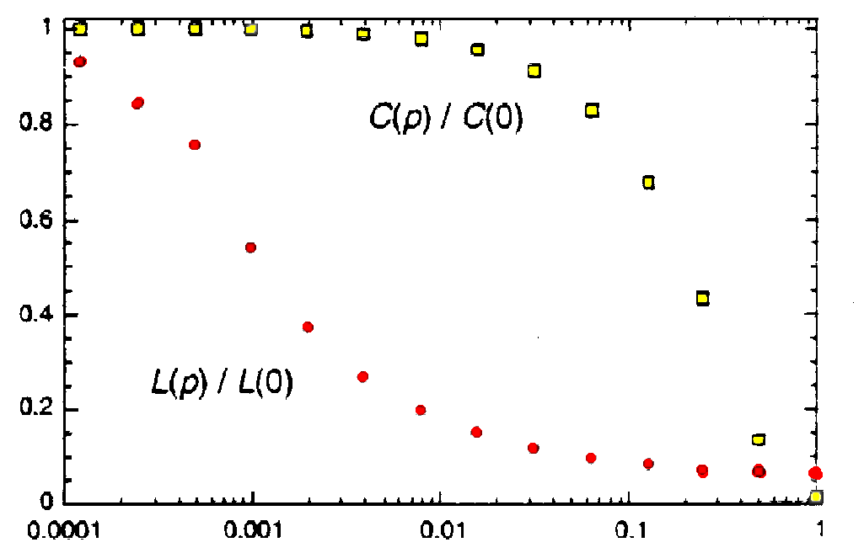
By varying the probability of rewiring edges
Duncan J. Watts & Steven H. Strogatz, Nature 393, 440-442 (1998)

Slide 21
Watts/Strogatz model: Clustering coefficient
C(p)/C(0)
p
Source: Watts, D.J., Strogatz, S.H.(1998) Collective dynamics of 'small-world' networks. Nature 393:440-442.
The probability that a connected triple stays connected after rewiring
probability that none of the 4 edges were rewired (1-p)⁴
Clustering coefficient = C(p) = C(p=0)*(1-p)⁴

Slide 22
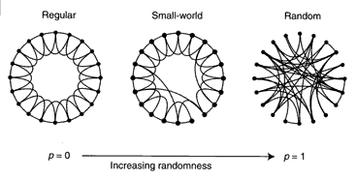
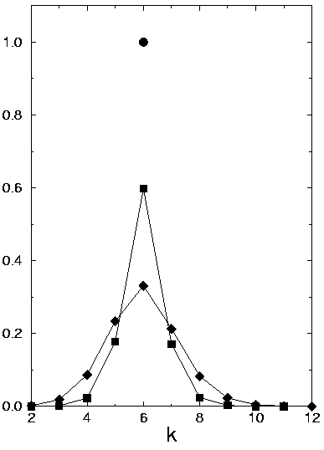
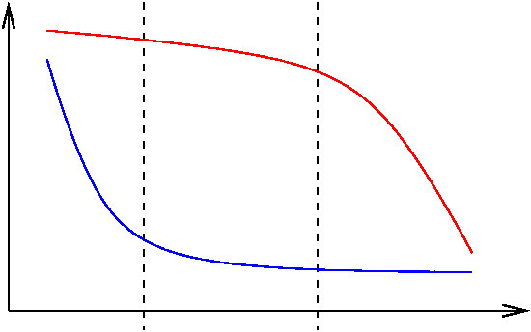
Watts-Strogatz Model
regular SW random
C
L
p
C(p) : clustering coeff. L(p) : average path length

Slide 23
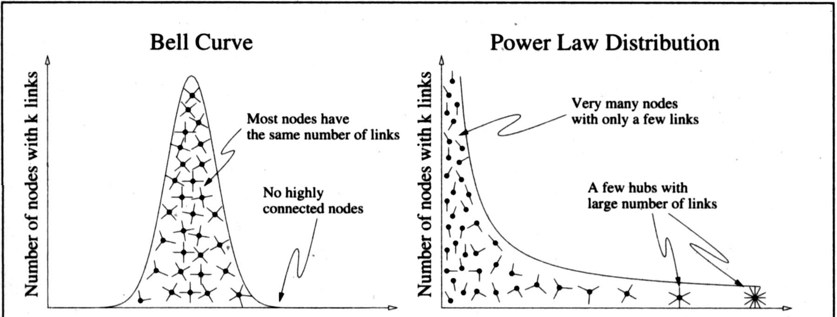
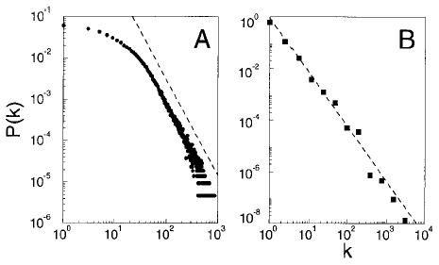
Did Watts and Strogatz Model Explain All ?
Network | n | k | L | C
WWW pages | 153127 | 35.21 | 3.1 | 0.1078
Internet AS | 6209 | 4.11 | 3.76 | .3
Math co-authors | 70975 | 3.9 | 9.5 | .59
Power Grid | 4941 | 2.67 | 18.7 | 0.08
E-coli reaction | 315 | 28.3 | 2.62 | .59

Slide 24
Network Properties
Average Distance between pairs (small)
Transitivity (high)
Degree Distribution (power law)
Network Resilience (weak under attack)

Slide 25
Five Models
Regular Model
Random Graph Model
Small World Model/Watts-Strogatz Model
Scale Free Model/Barabasi-Albert Model
Geographical Small World Model

Slide 26
Barabasi-Albert model
Each node connects to other nodes with probability proportional to their degree the process starts with some initial subgraph each node comes with m edges
Results in power-law with exponent α = 3
Notes:
26

Slide 27
Basic BA-model
start with an initial set of m₀ fully connected nodes
e.g. m₀ = 3
now add new vertices one by one, each one with exactly m edges
each new edge connects to an existing vertex in proportion to the number of edges that vertex already has → preferential attachment
easiest if you keep track of edge endpoints in one large array and select an element from this array at random
the probability of selecting any one vertex will be proportional to the number of times it appears in the array – which corresponds to its degree

Slide 28
generating BA graphs – cont’d
To start, each vertex has an equal number of edges (2)
the probability of choosing any vertex is 1/3
We add a new vertex, and it will have m edges, here take m=2
draw 2 random elements from the array – suppose they are 2 and 3
Now the probabilities of selecting 1,2,3,or 4 are 1/5, 3/10, 3/10, 1/5
Add a new vertex, draw a vertex for it to connect from the array
etc.
1 1 2 2 3 3
1 1 2 2 2 3 3 3 4 4
1 1 2 2 2 3 3 3 3 4 4 4 5 5

Slide 29
Properties of the BA graph
http://netlogoweb.org/launch#http://netlogoweb.org/assets/modelslib/Sample%20Models/Networks/Preferential%20Attachment.nlogo
https://www.youtube.com/watch?v=4GDqJVtPEGg
The distribution is scale free with exponent a = 3
The graph is connected
Every vertex is born with a link (m= 1) or several links (m > 1)
It connects to older vertices,
which are part of the giant component
The older are richer
Nodes accumulate links as time goes on
preferential attachment will prefer wealthier nodes,
who tend to be older and had a head start

Slide 30
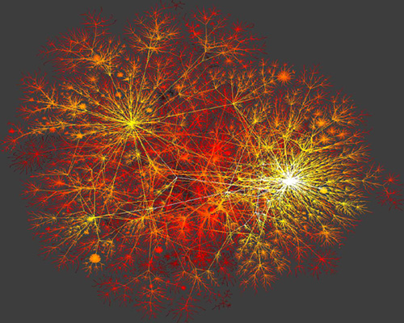

Slide 31
Network Properties
Average Distance between pairs (small)
Transitivity (high)
Degree Distribution (power law)
Network Resilience (weak under attack)

Slide 32
BA Model + Watts/Strogatz Model

Slide 33
Network Properties
Average Distance between pairs (small)
Transitivity (high)
Degree Distribution (power law)
Network Resilience (weak under attack)

Slide 35
Five Models
Regular Model
Random Graph Model
Small World Model/Watts-Strogatz Model
Scale Free Model/BA Model
Geographical Small World Model

Slide 36
Milgram’s experiment revisited
What did Milgram’s experiment show?
(a) There are short paths in large networks that connect individuals
(b) People are able to find these short paths using a simple, greedy, decentralized algorithm
Small world models take care of (a)

Slide 37


Kleinberg:
what about (b)?

Slide 38
The Algorithmic Side
Input:
Grid G = (V,E)
arbitrary nodes s, t
Goal: Transmit a message from s to t in as few steps as possible using only locally available information

Slide 39
t
s
Best Effort Routing

Slide 40
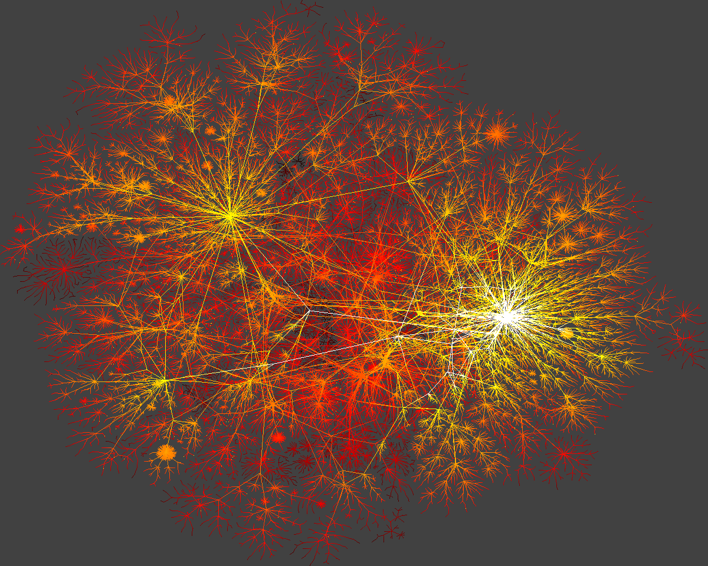

Slide 41
Navigation in a small world network
Kleinberg (2000)
Why should arbitrary pairs of strangers, using only locally available information, be able to find short chains of acquaintances that link them together?
Does this occur in all small-world networks, or are there properties that must exist for this to happen?

Slide 42
The Algorithmic Side
Assumptions:
In any step, the message holder u knows
The range of local contacts of all nodes
The location on the lattice of the target t
The locations and long-range contacts of all nodes that have previously touched the message
u does not know
the long-range contacts of nodes that have not touched the message

Slide 43
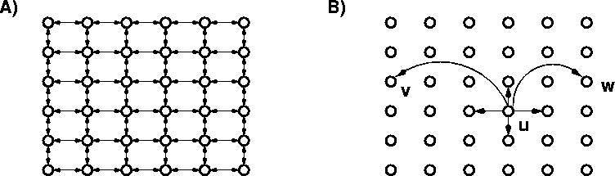
Kleinberg’s model
Consider a directed 2-dimensional lattice
For each vertex u add q shortcuts
choose vertex v as the destination of the shortcut with probability proportional to [d(u,v)]^{-r}
when r = 0, we have uniform probabilities

Slide 44
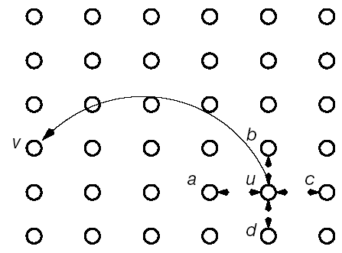
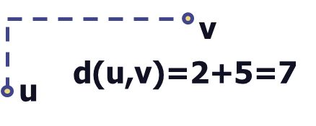
Kleinberg’s geographical small world model
nodes are placed on a lattice and
connect to nearest neighbors
additional links placed with p(link between u and v) = (distance(u,v))^{-r}
exponent that will determine navigability
Source: Kleinberg, ‘Navigation in a small world’

Slide 45
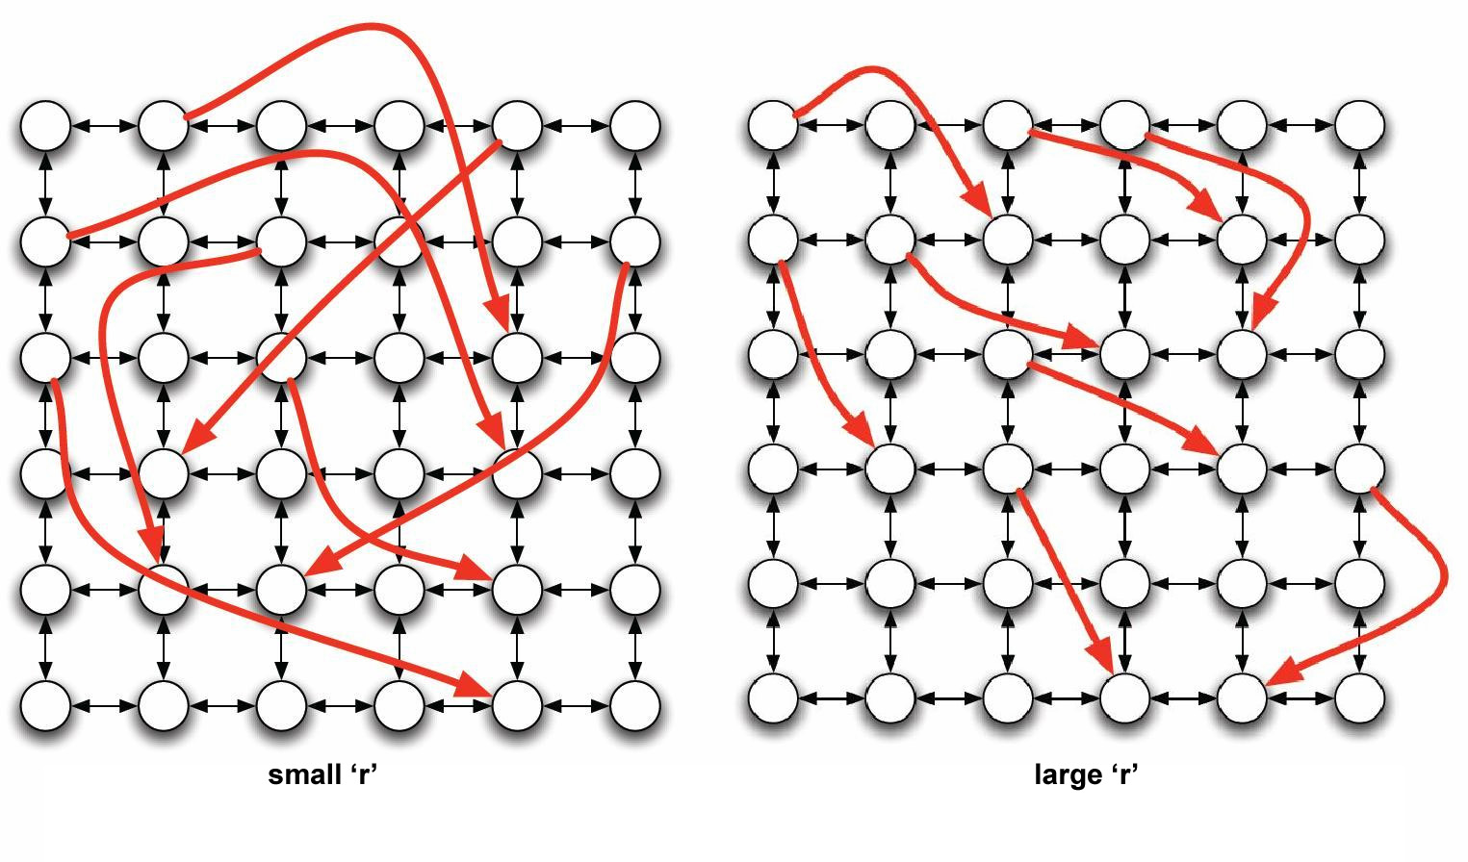
Navigation in a small world network
Infinite family of networks:
r = 0: each node’s long-range contacts are chosen independently of its position on the grid
As r increases, the long range contacts of a node become clustered in its vicinity on the grid.

Slide 46
Searching in a small world
Kleinberg proved the following
When r=2, an algorithm that uses only local information at each node can reach the destination in expected time O(log²n).
When r<2 a local greedy algorithm needs expected timeΩ(n^{(2-r)/3}).
When r>2 a local greedy algorithm needs expected time Ω(n^{(r-2)/(r-1)}).
Generalizes for a d-dimensional lattice, when r=d

Slide 47
geographical search when network lacks locality
When r=2, links are randomly distributed, ASP ~ log(n), n size of grid
When r<2, any decentralized algorithm is at least a₀n^{2/3}
When r<2,
expected time at
least α_{r}n^{(2-r)/3}

Slide 48
Overly localized links on a lattice
When r>2 expected search time ~ N^{(r-2)/(r-1)}

Slide 49
geographical small world model
Links balanced between long and short range
When r=2, expected time of a DA is at most C (log N)²

Slide 50
R=2

Slide 51
The Algorithm
In each step the current message holder passes the message to the contact that is as close to the target as possible.

Slide 52
t
s
t
1 | 2 | 3 | 4 | 5 | 6 | 7 | 8 | 9 | 10 | 11 | 12 | 13 | 14 | 15 | 16 | 17 | 18 | …
Phase 0
Phase 1
Phase 2
Phase 3
Phase 4

Slide 53
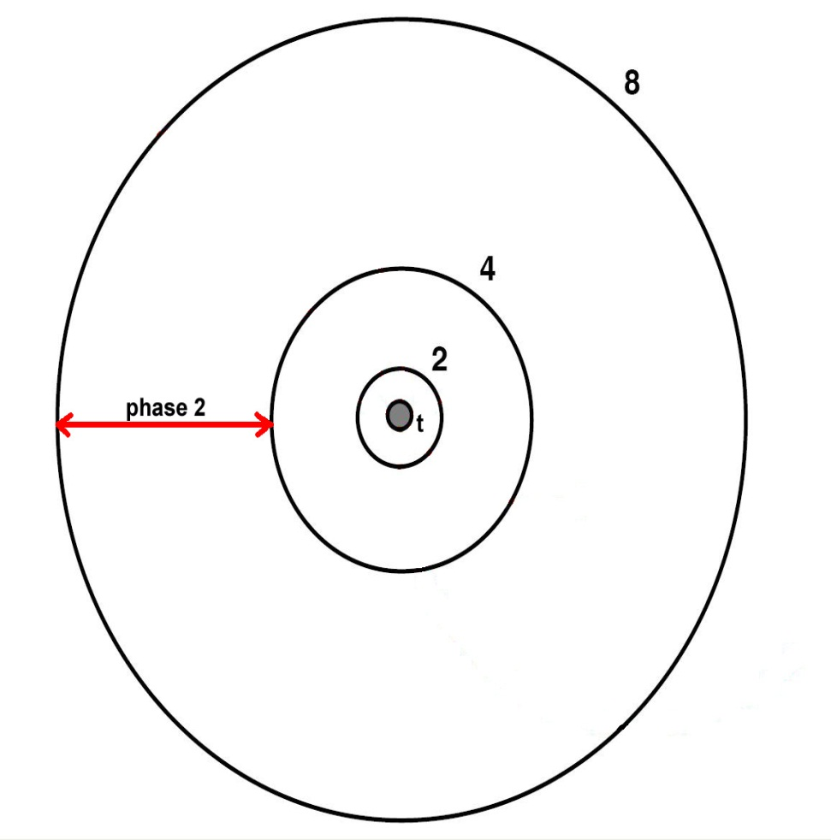
Analysis
Algorithm in phase j:
At a given step,
2^{j} < d(u,t) ≤ 2^{j+1}
Αlg. is in phase 0 :
message is no more than 2 lattice steps away from the target t.
j ≤ log₂ n.

Slide 54
Analysis
Questions:
How many steps will the algorithm take?
How many steps will we spend in phase j?
In a given step, with what probability will phase j end in this step?
What is the probability that node u has a node v in the next phase as its long range contact?
Notes:
Rephrase first question so that we don’t imply run time of alg.

Slide 55
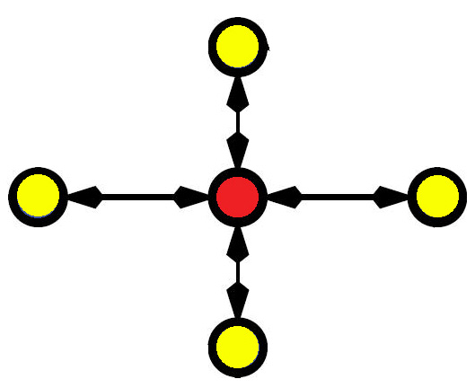
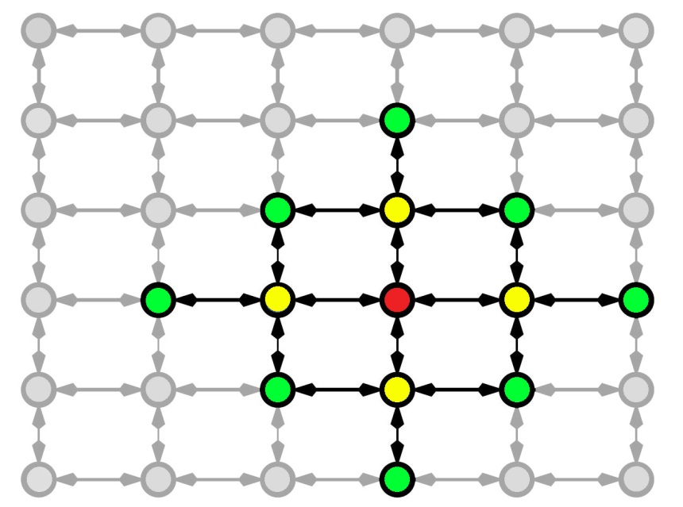
Analysis
Pr [ u has v as its long range contact ] ?
Questions:
How many steps will the algorithm take?
How many steps will we spend in phase j?
In a given step, with what probability will phase j end in this step?
What is the probability that node u has a node v as its long range contact?

Slide 56
Analysis
Pr[ u has v as its long range contact ]?
Thus u has v as its long-range contact with probability
Questions:
How many steps will the algorithm take?
How many steps will we spend in phase j?
In a given step, with what probability will phase j end in this step?
What is the probability that node u has a node v as its long range contact?

Slide 57
Analysis
In any given step, Pr[ phase j ends in this step ]?
Phase j ends in this step if the message enters the set B_{j} of nodes within distance 2^{j} of t. Let v_{f} be the node in B_{j} that is farthest from u.
Questions:
How many steps will the algorithm take?
How many steps will we spend in phase j?
In a given step, with what probability will phase j end in this step?
What is the probability that node u has a node v as its long range contact?

Slide 58
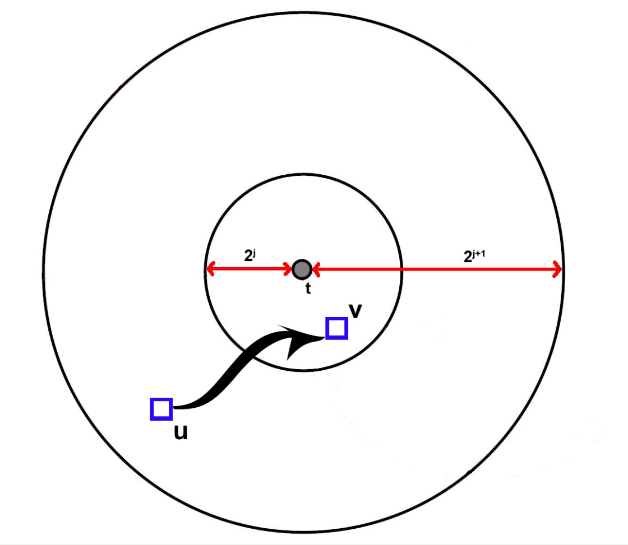
Analysis
What is d[(u,v_{f})]?
Questions:
How many steps will the algorithm take?
How many steps will we spend in phase j?
In a given step, with what probability will phase j end in this step?
What is the probability that node u has a node v as its long range contact?
≤ 2^{j} + 2^{j+1} < 2^{j+2}

Slide 59
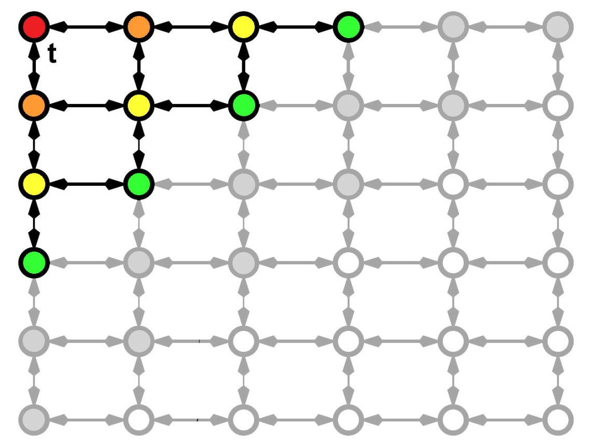
Analysis
How many nodes are in B_{j}?
Questions:
How many steps will the algorithm take?
How many steps will we spend in phase j?
In a given step, with what probability will phase j end in this step?
What is the probability that node u has a node v as its long range contact?

Slide 60
Analysis
In any given step, Pr[ phase j ends in this step ]?
Pr[ u has a long-range contact in B_{j} ]?
Questions:
How many steps will the algorithm take?
How many steps will we spend in phase j?
In a given step, with what probability will phase j end in this step?
What is the probability that node u has a node v as its long range contact?

Slide 61
Analysis
How many steps will we spend in phase j?
Let X_{j} be a random variable denoting the number of steps spent in phase j.
X_{j} is a random variable with a probability of success at least
Questions:
How many steps will the algorithm take?
How many steps will we spend in phase j?
In a given step, with what probability will phase j end in this step?
What is the probability that node u has a node v as its long range contact?

Slide 62
Analysis
How many steps will we spend in phase j?
Since X_{j} is a geometric random variable, we know that
Questions:
How many steps will the algorithm take?
How many steps will we spend in phase j?
In a given step, with what probability will phase j end in this step?
What is the probability that node u has a node v as its long range contact?

Slide 63
Analysis
How many steps will we spend in phase j?
Let X_{j} be a random variable denoting the number of steps spent in phase j.
Questions:
How many steps will the algorithm take?
How many steps will we spend in phase j?
In a given step, with what probability will phase j end in this step?
What is the probability that node u has a node v as its long range contact?

Slide 64
Analysis
How many steps does the algorithm take?
Let X be a random variable denoting the number of steps taken by the algorithm.
By Linearity of Expectation we have
Questions:
How many steps will the algorithm take?
How many steps will we spend in phase j?
In a given step, with what probability will phase j end in this step?
What is the probability that node u has a node v as its long range contact?

Slide 65
Analysis
When r = 2, expected delivery time is
O(log n)²
Questions:
How many steps will the algorithm take?
How many steps will we spend in phase j?
In a given step, with what probability will phase j end in this step?
What is the probability that node u has a node v as its long range contact?

Slide 66
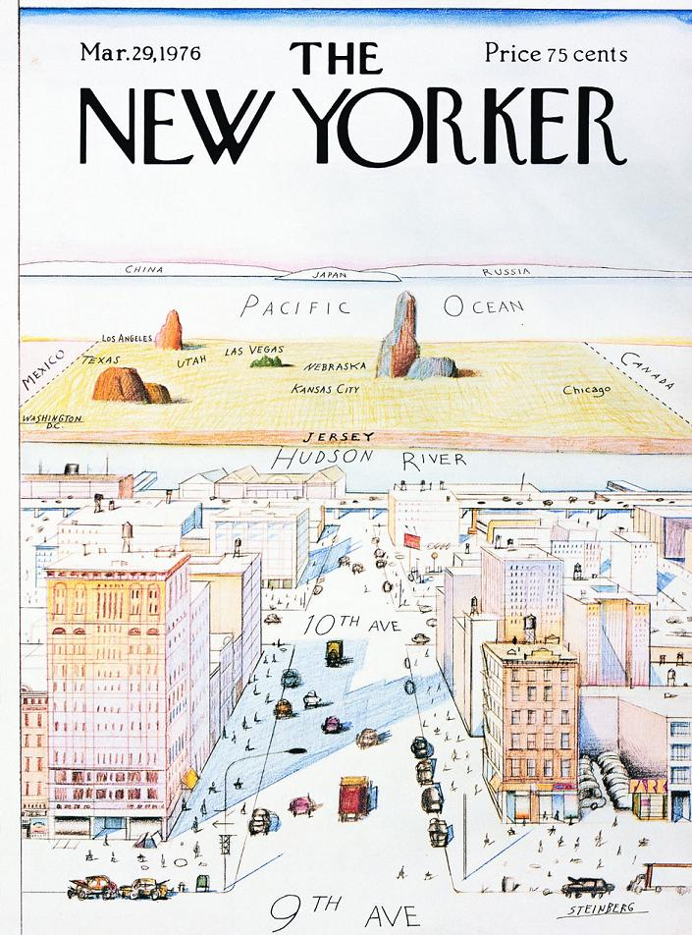
512
1024
512

Slide 67

s
t
1 | 2 | 3 | 4 | 5 | 6 | 7 | 8 | 9 | 10 | 11 | 12 | 13 | 14 | 15 | 16 | 17 | 18 | … | … | 32
Section 0
Section 1
Section 2
Section 3
Section 4
Probability of having a long distance friend at Section 4
=
Probability of having a long distance friend at Section 0, 1, 2, 3

Slide 68
BA Model + Watts/Strogatz Model+ Geographical Model

Slide 69
Mimic a small world system to design
a data storage system
Given a huge set of computers, how to utilize
them to have a data storage system
P1: how data are stored
P2: how data are efficiently retrieved
Q:xyz.doc
A
As a system

Slide 70
P1: How data are stored ?
Content Addressable
0 | 1 | 2 |  | … |  |  |  | 14 | 15
Hash( ) = 14
Q( )
= Hash ( )
= 14
abc.doc
abc.doc
Hash( ) = 0
xyz.doc
abc.doc

Slide 71
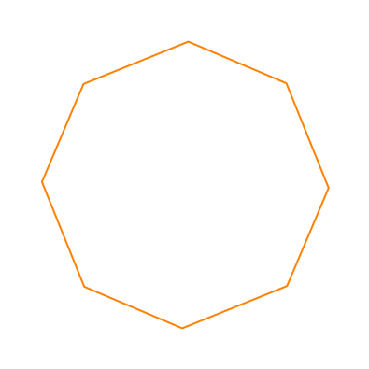
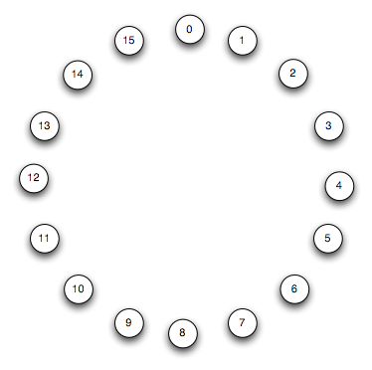
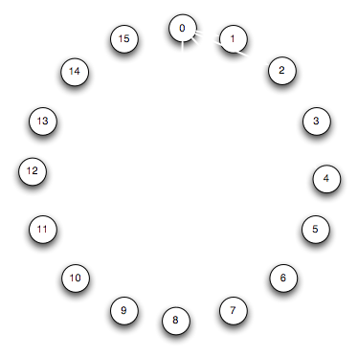
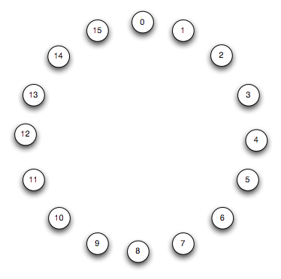
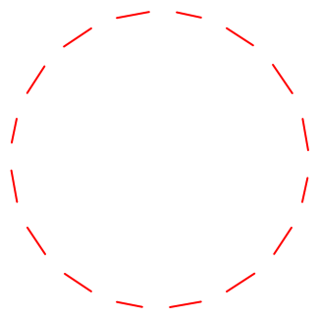
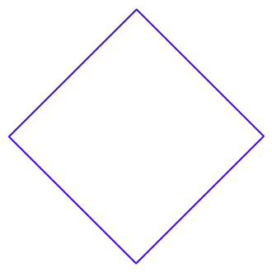
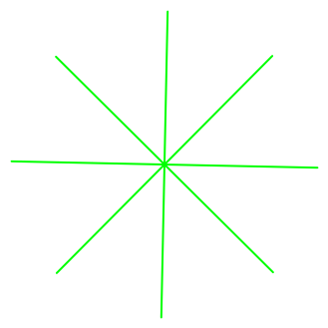
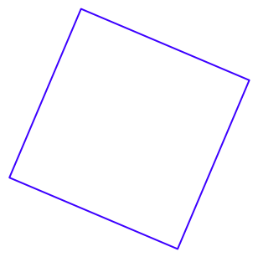
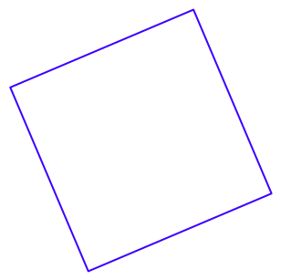



P2: How data are retrieved ?
Q ( )
abc.doc
Small World Like Topology

Slide 72

Hash (data) =14
2
6
12
35

Slide 73
Thoughts
What about a well-structured network?
What about a p2p like network?

Slide 74
Assignment 2: Social Network Visualization
Learn to Use Social Network Visualization Tool
Draw a picture for the social network of the characters in the following novel:
天龍八部
笑傲江湖
絕代雙驕
神鵰俠侶+射鵰英雄傳
倚天屠龍記
A node stands for a character
An edge between two characters stands for the relationship that the characters co-appear in a paragraph
Web based Presentation Only! Deadline 03/26

Slide 75
Assignment 3: Social Network Visualization
In addition, compute the following measures over the social network you construct.
Average Degree
Average clustering coefficient
Diameter
Degree Distribution
Closeness Centrality
Make a short presentation to what you saw

Slide 76
Closeness Centrality
In a connected graph, closeness centrality (or closeness) of a node is a measure of centrality in a network, calculated as the sum of the length of the shortest paths between the node and all other nodes in the graph. Thus the more central a node is, the closer it is to all other nodes.

Slide 77
